Slide 1


Impacts of COVID-19 in the Economy and Vaccines Around the World
By: Sneha Kumaran
CDS 301
Department of Computational and Data Sciences, George Mason University, Fairfax, VA

Slide 3
Introduction
Topics: Vaccination progress and Economy impact by COVID-19
This is important because this is an ongoing issue in today’s world as we are in a pandemic. Every factor will contribute to the impact of COVID-19. This means the economy will impacted due to factors like small businesses, domestic trade, technology use, transportation, and etc. There were major changes in the society, which led to the research on the urge of people becoming vaccinated around the world and the change/adaptation of the society for normalization.

Slide 4
Related Research & Research Questions
Research Question1: How rapidly are people being vaccinated around the world ?
Research Question 2: How has COVID-19 impacted the economy?
The related research is about the how people are in the urge to become vaccinated. So, there is research to how many cases are recorded and how many people are recovering as well as taking the vaccines. People are taking measures to try to slow down the spread as soon as they can. This is also linked to how people are impacted through the change of the economy. As transportation of flying has been declined.

Slide 5
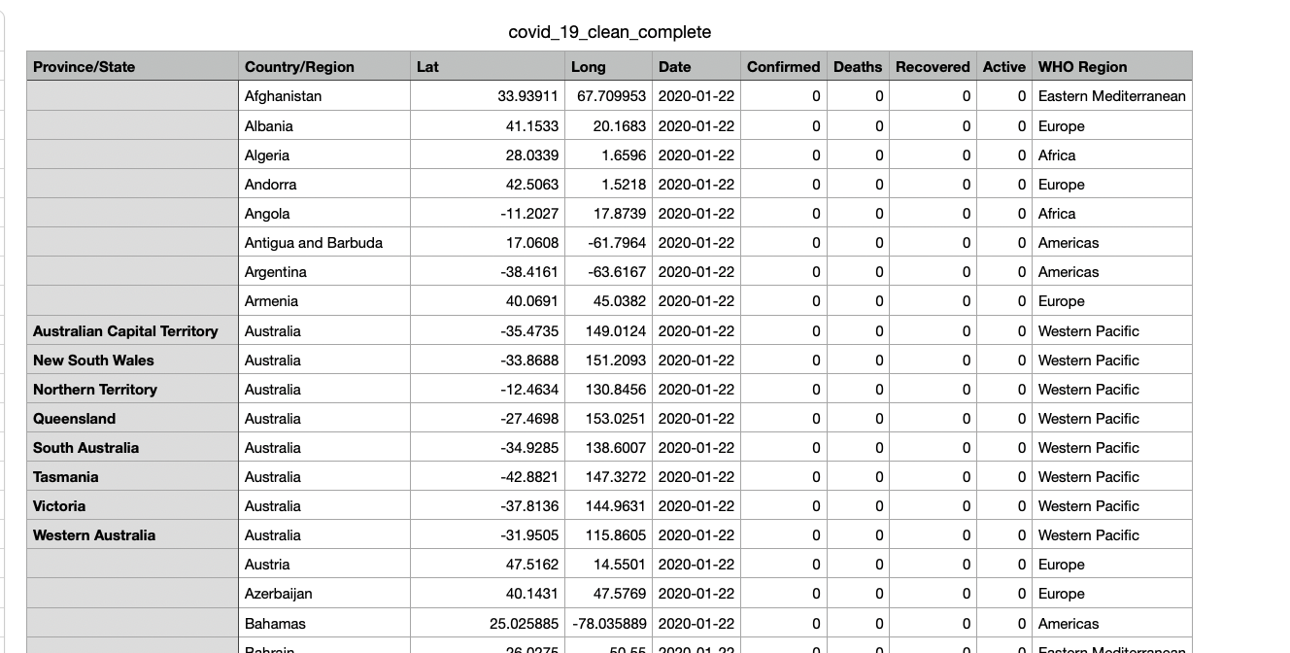
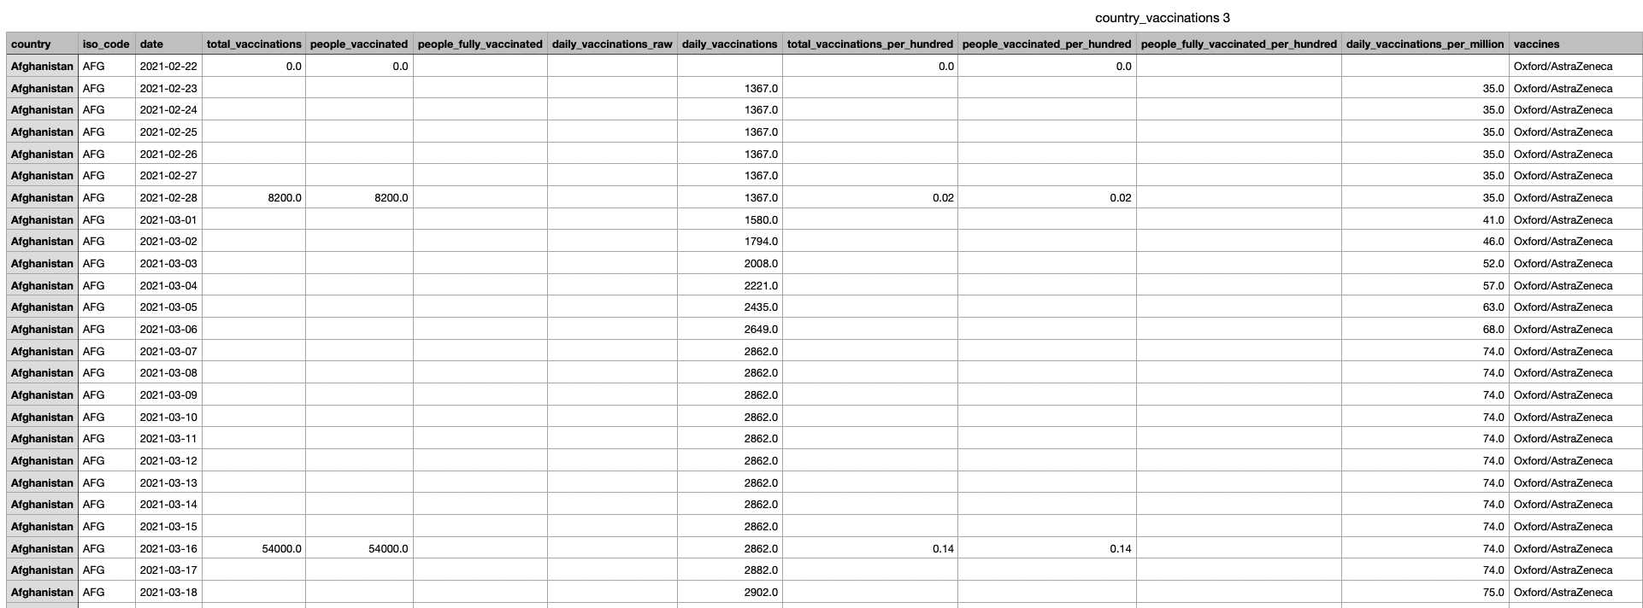
Data
Title: COVID-19 Dataset
Description: Number of Confirmed, Death and Recovered cases every day across the globe
Title: COVID-19 World Vaccination Progress
Description: Daily and Total Vaccination for COVID-19 in the World

Slide 6
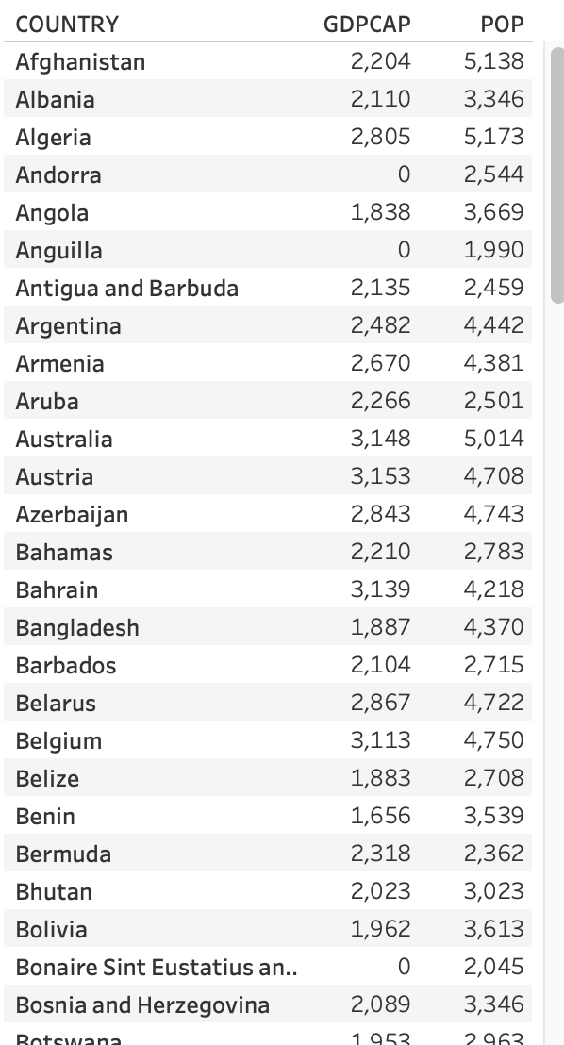
Data
Title: Impact of Covid-19 Pandemic on the Global Economy
Description: Economic Growth based off of COVID-19
50,000+ data combined
Also table used as analysis

Slide 7









Preprocessing
Topic was chosen and two data from Kaggle
Cleaned the columns and rows, filled in empty cells
Made a data table based off of the cleaned up data
Filtered out the specific attributes
Used the filtered attributes to make a visual (bar graph, pie chart, map, etc.)

Slide 8
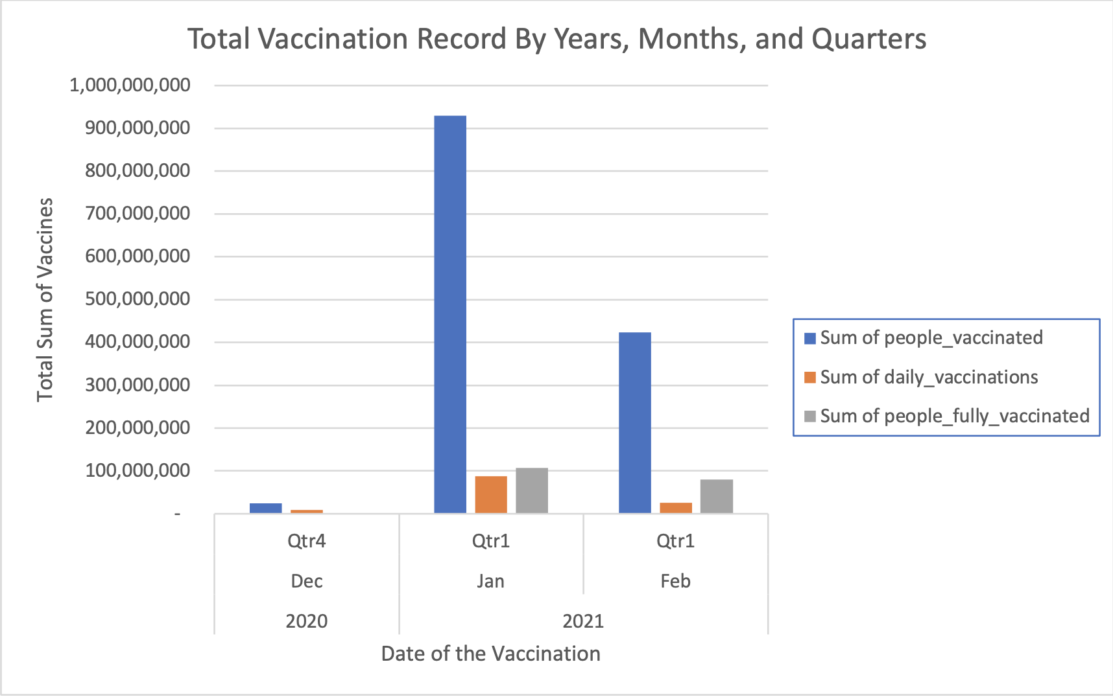
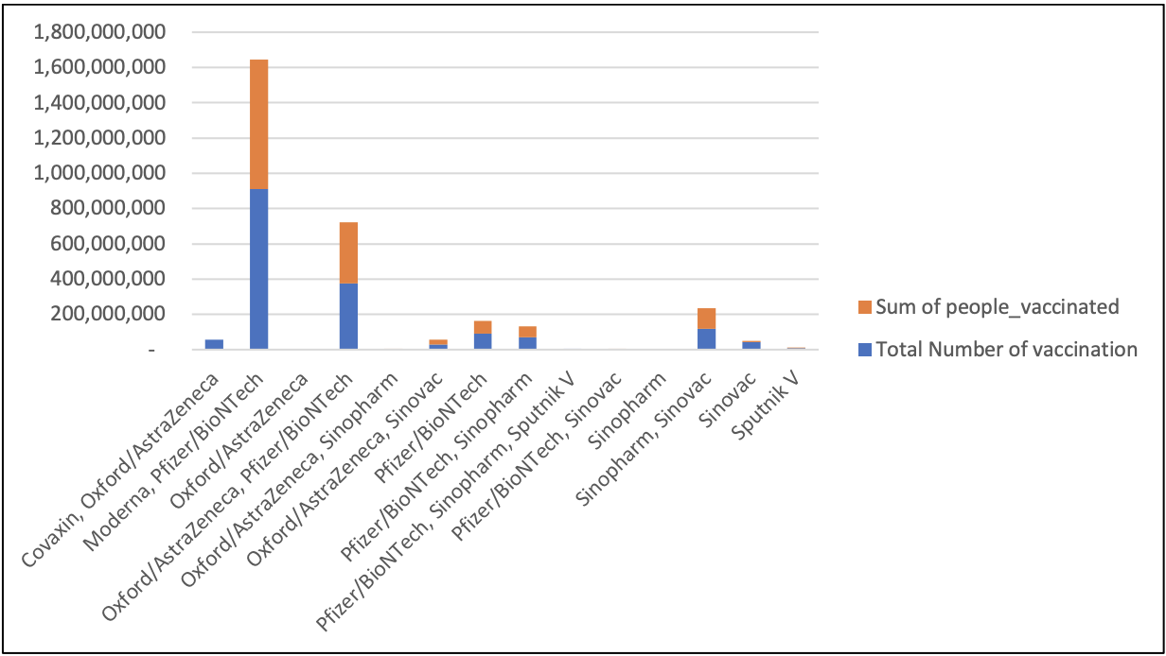
Methods and Analysis
Used Excel and Tableau
To analyze the data visually, I wanted to know the type of vaccines created and which ones the population has vaccinated the most. With the use of tableau, it helped me put together the table of the economic growth which combined data of GDP data track and country names along with population per country impacted within COVID-19. Clearly we can analyze which months were vaccinated the most (Jan 2021) and growth rate (GDP) was almost 10% for United States, India 9%, Chile 10%, and Iceland 10%.

Slide 9
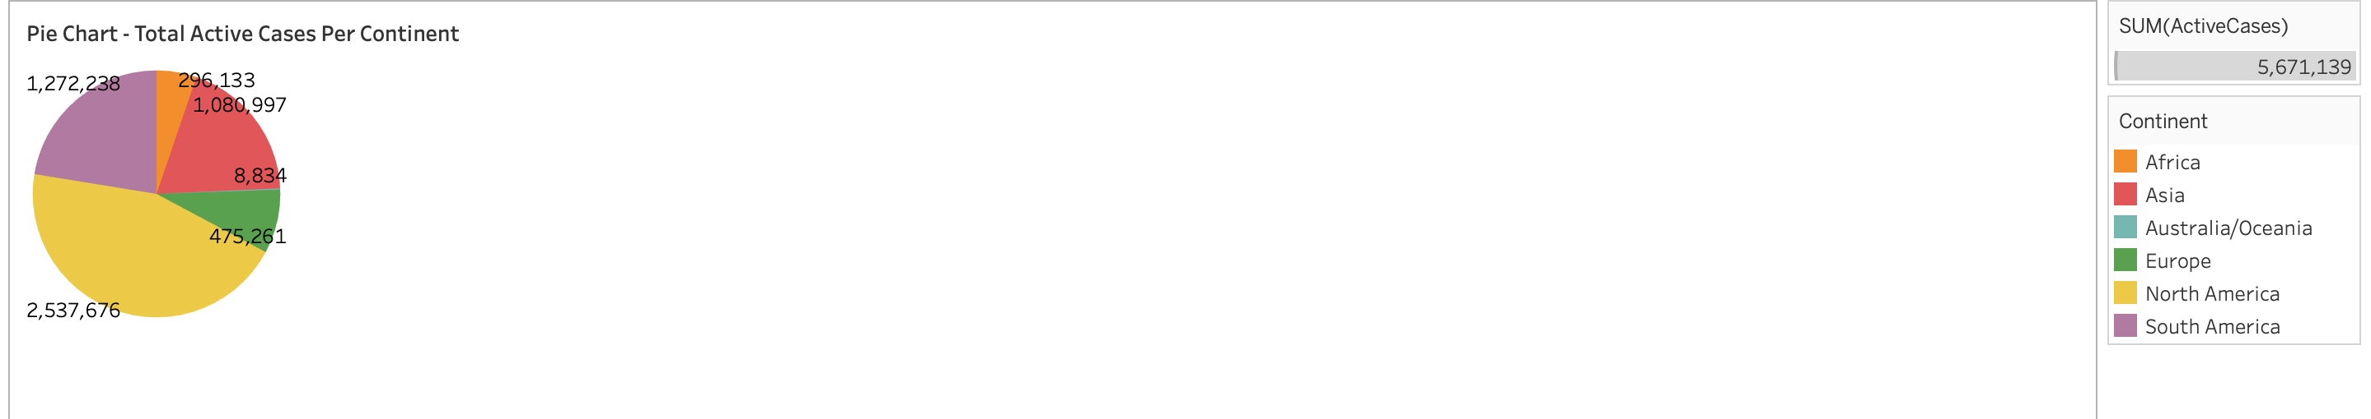
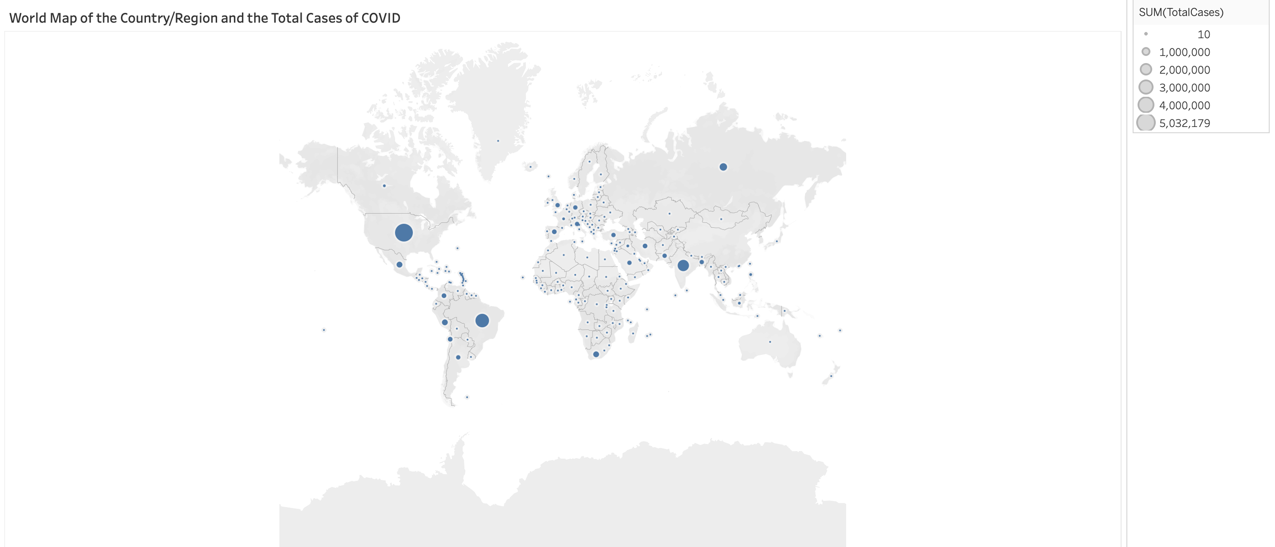
Results
The pie chart shows how many total active cases per continent
The most total cases would be North America.
The map depicts the major impacted countries that have been affected by the COVID-19 (total cases).
The bigger circles resemble the most total cases.

Slide 10
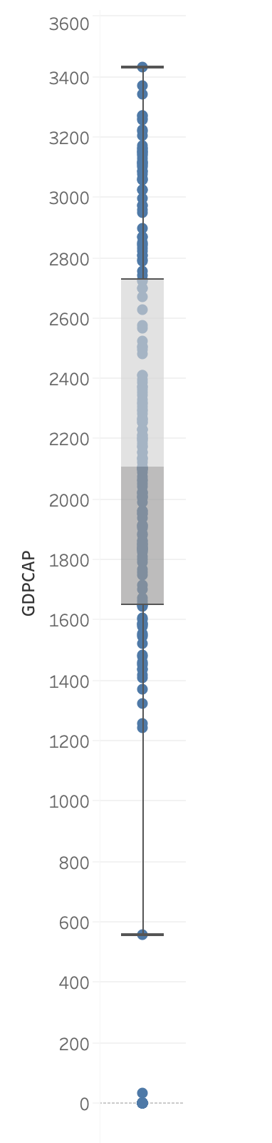
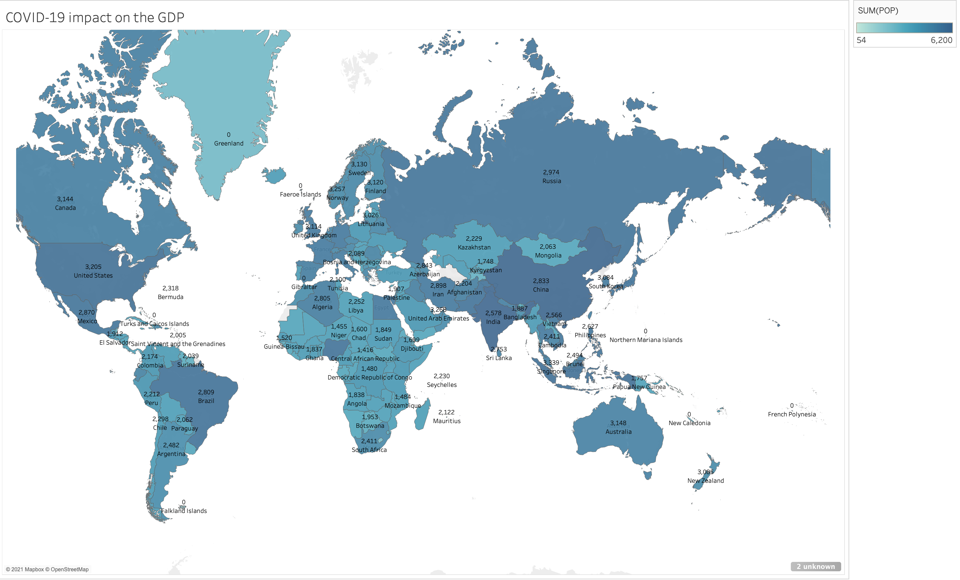
Results
This world map shows the sum of total GDP on how COVID-19 has impacted the global economy. United states and most of Asia are impacted
This is a box and whisker plot the GDP Cap is mostly around 1700-2700 There are some outliers that have 0

Slide 11
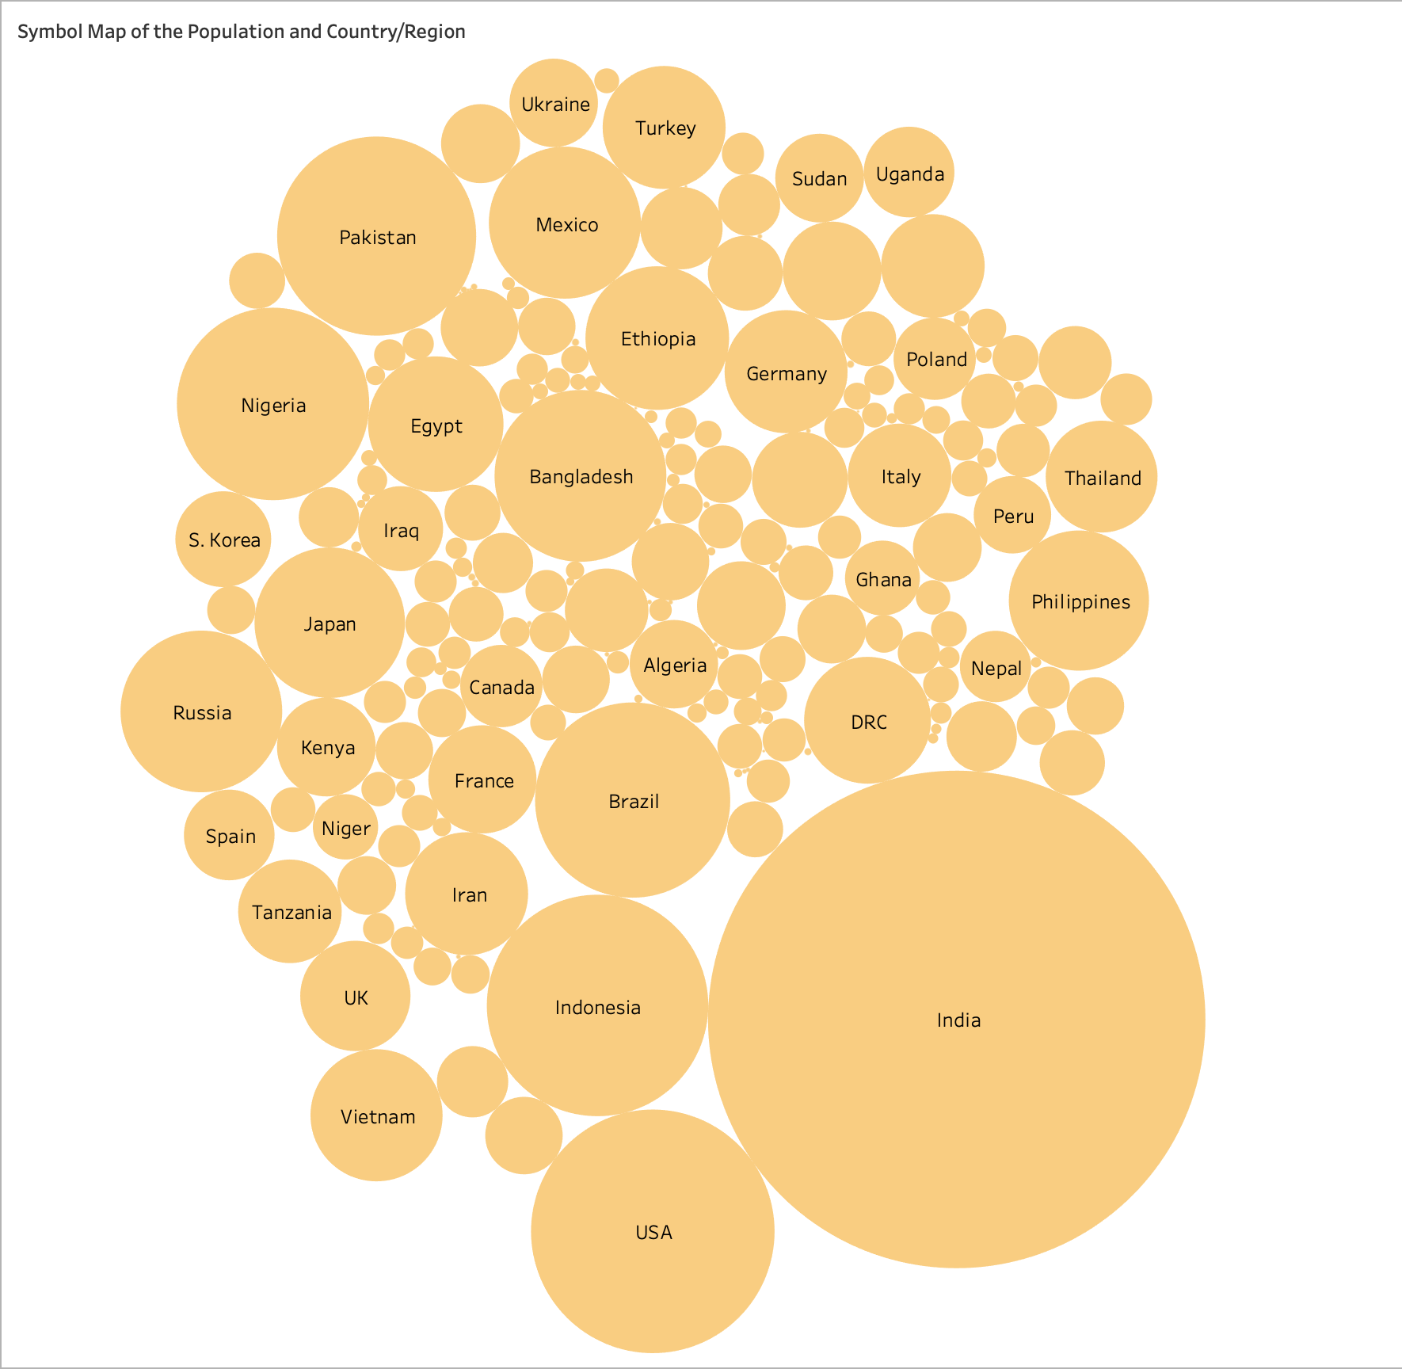
Results
This is a packed bubble visualization depicting the biggest circle to be the most impacted in all circumstances of factors due to COVID-19
The biggest bubble would be India as they are most impacted population as of right now

Slide 12
Discussion and Conclusion
In GDP Capita as people are being recovered and vaccinated has been increasing in trade, increasing in manufacturing mainly due to the medical supplies, the use of delivery from food, packages, transportation everything has to do with affecting the economy. So, every factor is impacted due to COVID-19
This research is important to understand how the COVID-19 is impacting the economy and how people are running to get vaccinated and push forth in lowering the spread.
Future Work: Find more datasets to do cross comparison on certain factors like small businesses, transportation, behavioral changes of people that are impacted by COVID-19.

Slide 13
References
Gupta, M., Abdelmaksoud, A., Jafferany, M., Lotti, T., Sadoughifar, R., & Goldust, M. (2020). COVID-19 and economy. Dermatologic therapy, 33(4), e13329. https://doi.org/10.1111/dth.13329
Prompetchara E, Ketloy C, Palaga T. Immune responses in COVID-19 and potential vaccines: Lessons learned from SARS and MERS epidemic. Asian Pac J Allergy Immunol. 2020 Mar;38(1):1-9. doi: 10.12932/AP-200220-0772. PMID: 32105090.
Xiong, J., Lipsitz, O., Nasri, F., Lui, L., Gill, H., Phan, L., Chen-Li, D., Iacobucci, M., Ho, R., Majeed, A., & McIntyre, R. S. (2020). Impact of COVID-19 pandemic on mental health in the general population: A systematic review. Journal of affective disorders, 277, 55–64. https://doi.org/10.1016/j.jad.2020.08.001

Slide 14
Thank you for listening!!
Have any questions? Please feel free to add them to the discussion board thread for this poster

